Slide 1

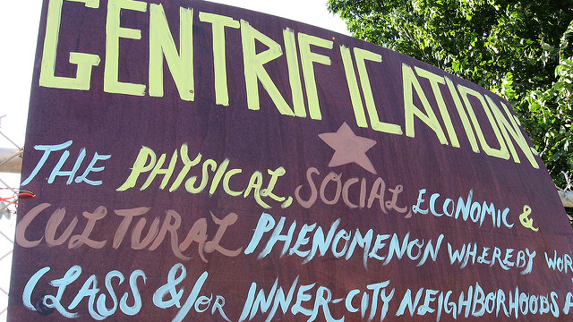
GentRIFICATION OF RICHMOND
THE CORRELATION BETWEEN THE CITIES GENTRIFIED NEIGHBORHOODS, CRIME RATES, & COST OF HOUSING
U of R Data Analytics Bootcamp
Project #1- September 2021

Slide 2




TEAM SOCIOTRACKER
Joseph March
Angela Angulo
Marisa Kiger
Bonnie Bailey

Slide 3



Gentrification- the process whereby the character of a poor urban area is changed by wealthier people moving in, improving housing, and attracting new businesses, typically displacing current inhabitants in the process. https://languages.oup.com/google-dictionary-en/

Slide 4

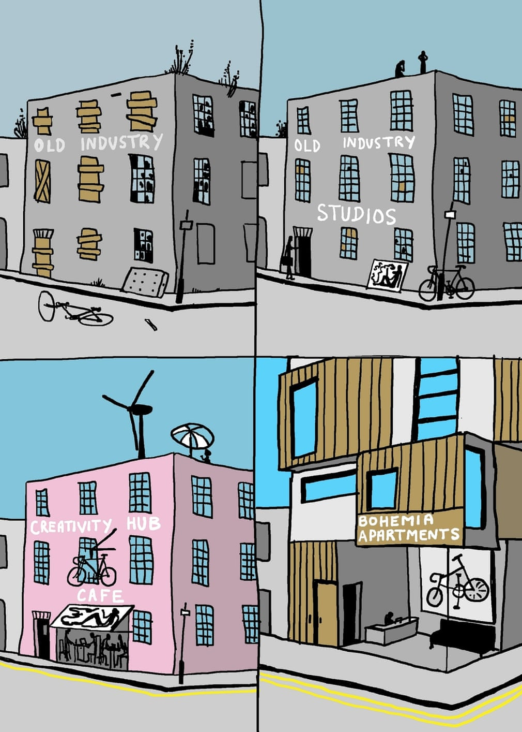
MOTIVATION & SUMMARY Hypothesis: An expectation that crime reported will decrease as average housing values increase for neighborhoods. Research Questions: -How does gentrification affect crime rates? -how does the rate of crime correlate to the cost of housing?
WHY DID WE ASK THESE QUESTIONS:
Gentrification is not something that occurs overnight. It is a process over time. Our study is to determine whether or not crime rates were affected throughout this time frame by looking at trends over multiple years. Then to determine how the cost of housing in these gentrified areas correlated to that crime rate.
SUMMARY:
While there is a weak negative correlation between housing values and crime rate in all of Richmond overall, we do see patterns arise among the 7 gentrified neighborhoods we reviewed.

Slide 5
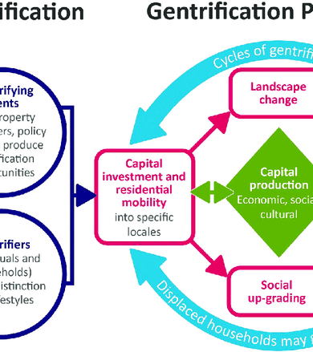
QUESTIONS & DATA
Data pulled on crime rates and housing prices based on neighborhoods in Richmond.
Resources:
Crime Data- https://www.richmondgov.com
Zillow- https://www.zillow.com/research/data/
Google Maps/Street View
Census Data- https://www.census.gov/quickfacts/fact/table/richmondcitycountyvirginia,richmondcityvirginia/PST045219
Mapline- https://mapline.com/

Slide 6
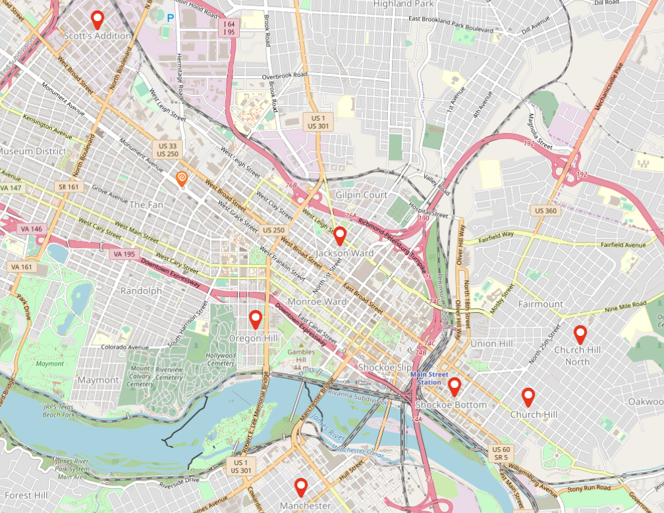
Process
Due to the large amount of data, we chose to narrow the field to 7 of the regions that have shown the most gentrification and growth since the Year 2000:
Shockoe Bottom
Scott’s Addition
Church Hill
Church Hill North
Oregon Hill
Manchester
Jackson Ward

Slide 7
Refer to the Jupyter Notebook located in our GitHub Project Repository:
https://github.com/designergal3002/Team-Sociotracker/blob/main/sociotracker_AngelaCopy.ipynb
Jupyter Notebook: Sociotracker (currently called sociotracker_AngelaCopy.ipynb)
Uploads crime data by year from https://www.richmondgov.com
Adds Total Crime and Percent Change columns to the crime data.
Runs a function we created to select a location from the crime data and build a DataFrame showing all years from 2000 – 2020 as rows.
Creates a combined DataFrame of the average crime data for all of Richmond.
Uploads Average House Prices by month per Neighborhood from Zillow.
Converts Zillow data into Average House Prices per year from 2000 – 2020.
Runs a function we created to select a location from the Zillow data and provide Average House Prices per year and Price Percent Change in a new DataFrame, to be merged with crime DataFrame later.
Pulls crime and average house price data for Church Hill, Church Hill North, Jackson Ward, Manchester, Scott’s Addition, Shockoe Bottom, and Oregon Hill as well as the averages for Richmond as a whole using functions we made.
Saves all pulled data as csv files for use in plotting code via different Jupyter Notebook.
Calls Census API to pull per capita income by zipcode (not used in the long run due to inability to match either zipcode or tracts with Richmond neighborhoods).
DATA CLEANUP & EXPLORATION

Slide 8
DATA CLEANUP & EXPLORATION
Refer to the Jupyter Notebook located in our GitHub Project Repository:
https://github.com/designergal3002/Team-Sociotracker/blob/main/CrimeTypeData.ipynb
Jupyter Notebook: Crime Type Data (currently called CrimeTypeData.ipynb)
Uploads the data saved as csvs from the prior notebook (all locations and Richmond as a whole).
Creates a new DataFrame that shows the violent vs. non-violent crime for each location for both 2000 and 2020.
Refer to the Jupyter Notebook located in our GitHub Project Repository:
https://github.com/designergal3002/Team-Sociotracker/blob/main/Scatter_data.ipynb
Jupyter Notebook: Scatter Data (currently called Scatter_data.ipynb)
Uploads the original crime data and Zillow data for all neighborhoods in Richmond.
Creates a new DataFrame showing 2000, 2010, and 2020 Total Crime and Average House Price
Refer to the Jupyter Notebook located in our GitHub Project Repository:
https://github.com/designergal3002/Team-Sociotracker/blob/main/Scatter_data2.ipynb
Jupyter Notebook: Scatter Data 2 (currently called Scatter_data2.ipynb)
Rewrite of scatter data that pulls for all years.
Refer to the Jupyter Notebook located in our GitHub Project Repository:
https://github.com/designergal3002/Team-Sociotracker/blob/main/Percent_change.ipynb
Jupyter Notebook: Percent Change (currently called Percent_change.ipynb)
Added calculation for percent change over time of crime and housing data

Slide 9
Data Analysis
Refer to the Jupyter Notebook located in our GitHub Project Repository:
https://github.com/designergal3002/Team-Sociotracker/blob/main/sociotracker_graphs_working.ipynb
1- SCATTER PLOT- TOTAL CRIME VS AVG HOUSE VALUE 2000-2020
2- LINE GRAPH- ALL NEIGHBORHOODS IN RVA AVG HOUSE VALUE 2000-2020
3- LINE GRAPH- ALL NEIGHBORHOODS IN RVA REPORTED CRIME 2000-2020
4- CRIME BAR ANALYSIS- 2000-2020
5- LINE GRAPHS- CRIME VS HOUSING VALUE 2000-2020
GRAPH REPRESENTING EACH OF OUR 7 PRIMARY NEIGHBORHOODS
6- BOX & WHISKER ANALYSIS- CRIME & AVG HOUSE VALUE 2000-2020

Slide 10
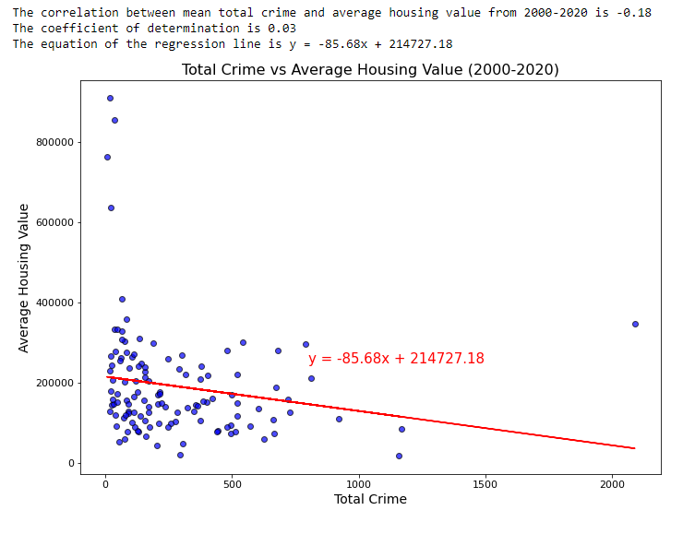

Scatter Plot- Total Crime vs Average House Value 2000-2020 Expected Outcome - strength of correlation >0.7 Summary Evaluation- Strength of Correlation -0.18 = Very weak correlation
Notes:
Outliers affecting the overall correlation.

Slide 11
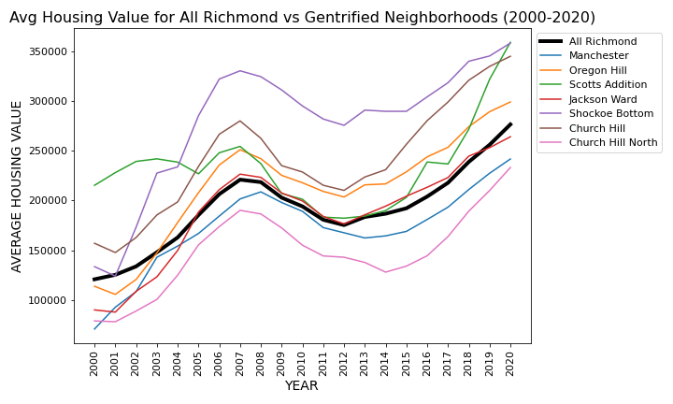
Line graph- all neighborhoods IN RVA Avg House value 2000-2020 Black line- Richmond used as Control Summary evaluation- All Neighborhoods showed an increase in average home value price. Noted: some changed at different rates.
Notes:
Important to mention- Dip between 2008- 2012 correlates to the housing crisis balloon.

Slide 12
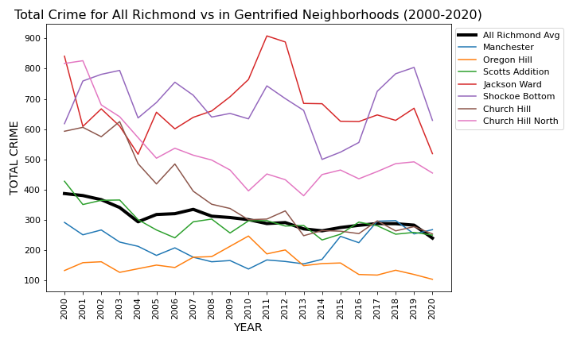
Line graph- all neighborhoods IN RVA reported Crime 2000-2020 Black line- Richmond used as Control Summary evaluation- All Neighborhoods showed a decrease in crime, with the exception of Manchester and Shockoe Bottom.
Notes:
All areas showed a reduction in crime, except for Manchester and Shockoe Bottom.
The data collected for this study does not provide additional insights necessary to determine what factors affected Manchester crime.

Slide 13
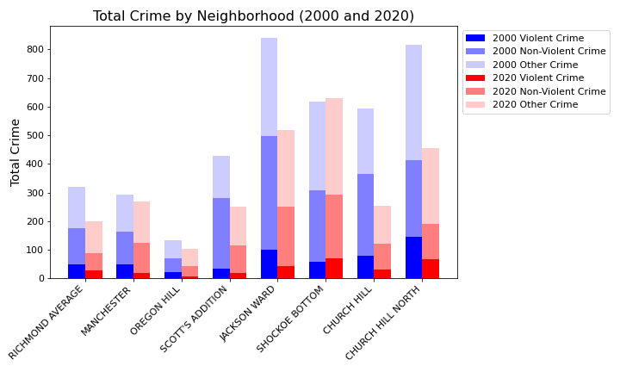
Crime bar analysis- 2000-2020 Expected Outcome - reduction in violent crimes and increase in non-violent crime. Formula used = Violent Crimes (Homicide, Sex Offense, Robbery, and Assault), Non-Violent Crimes (Burglary, Theft, Vice, and Vehicle Theft), and Other. All neighborhoods decreased in both violent and non-violent crime except for Shockoe Bottom.
Notes:
Shockoe Bottom showed a slight increase in violent crimes 2020 = 59 reports and 2020 = 70 reports. The most reported violent crime was assault.

Slide 14
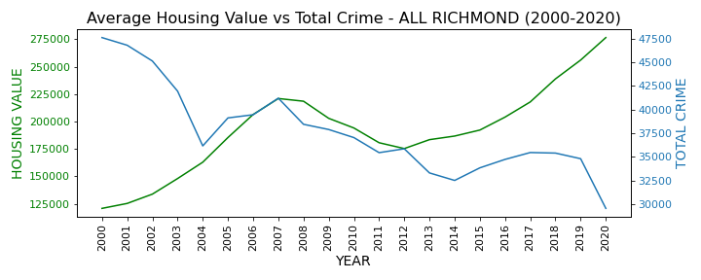
Line graph- Crime vs avg Housing Value 2000-2020 Expected Outcome - inverse relationship.

Slide 15
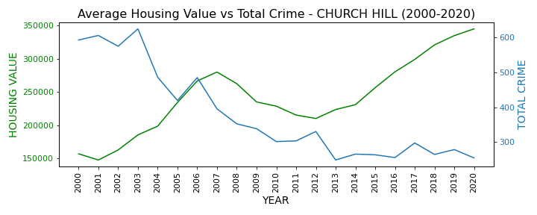
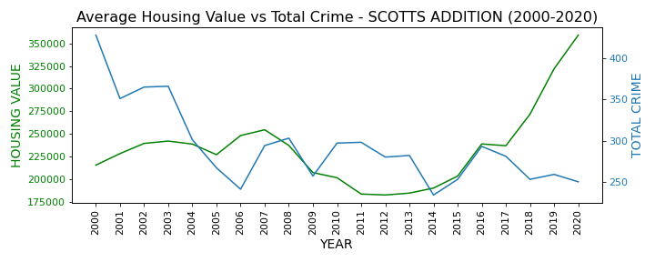
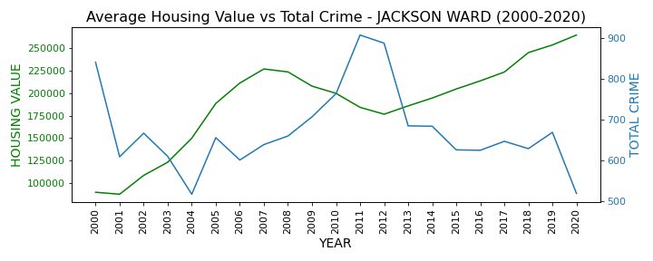
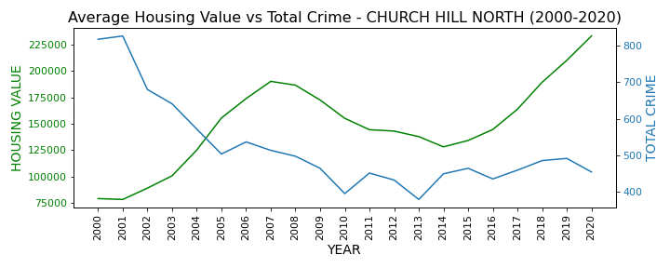
SUMMARY OUTCOME- THESE NEIGHBORHOODS (SCOTTS ADDITION, CHURCH HILL & CHURCH HILL NORTH, AND JACKSON WARD) SHOWED THE EXPECTED OUTCOME

Slide 16
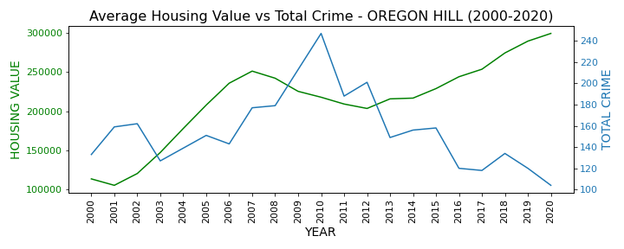
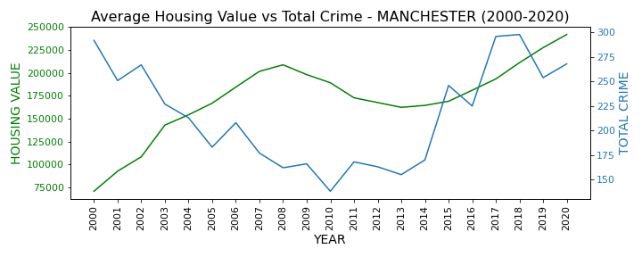
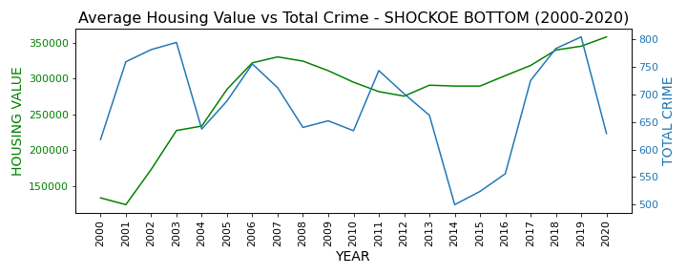
SUMMARY OUTCOME- THESE NEIGHBORHOODS (MANCHESTER, OREGON HILL, AND SHOCKOE BOTTOM) DID NOT SHOW THE EXPECTED OUTCOME.
Notes:
Manchester shows slight increase in crime. Further studies necessary to determine factors influencing crime in Manchester.

Slide 17
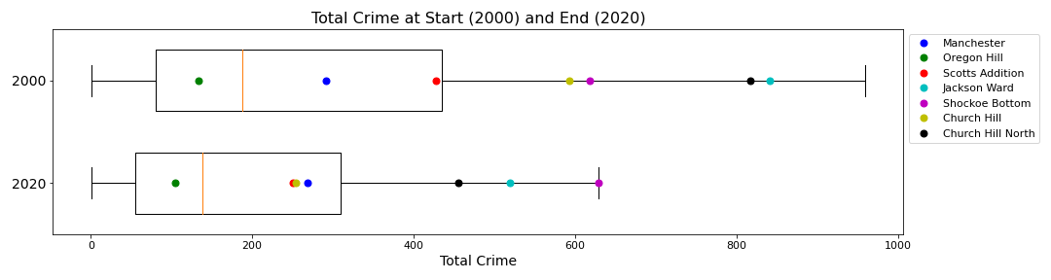
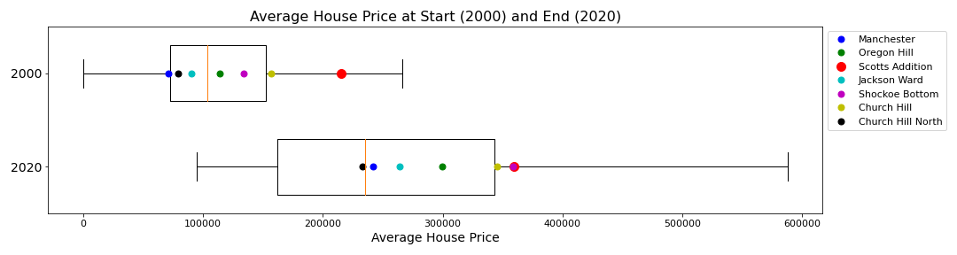
Box and Whisker analysiS- CRIME & AVG HOUSE VALUE 2000-2020 Expected Outcome – Relatively similar distribution of neighborhoods from 2000-2020. Overall expected outcome was seen for housing, but not for crime.

Slide 18
Discussion
Findings-
The overall correlation was weak between total crime and average house value for Richmond as a total.
4 of the 7 selected neighborhoods did show an inverse relationship between the total crime rate and average house value.
3 of the 7 selected neighborhoods did not behave as expected.
Conclusion-
We did not find what was expected in each case, potentially because neighborhoods are developing at different rates. Location and distance from the city center may also affect results. Percentage of commercial real estate vs residential could have impacts as well.

Slide 19
POST MORTEM
Difficulties That Arose:
Time barriers
Differences in source data
Additional Questions That Arose:
Are other factors contributing to crime such as poverty rate, population, and residential demographics
How did the overall demographics of homeowners and business owners change as the neighborhoods developed.
What we would study next (If we had 2 more weeks):
Pull more meaningful information from Census data.
Find statistics on what type of commercial development had occurred within each neighborhood.
Determine population demographics at beginning and end.

Slide 20

QUESTIONS?

